Slide 1
Overview of Object Oriented
Session 14
(Tutorial)
Course : Program Design Methods
Effective Period : July 2018

Slide 2
These slides have been adapted from
Britton, C.. (2005). A student Guide to Object Oriented Development. 01. Butterworth-Heinemann. Amsterdam. ISBN: 978-0-7506-6123-2. Chapter 4
Acknowledgement

Slide 3
LO 5 : Explain the object oriented design
Learning Objectives

Slide 4
Contents
Abstraction
Class & Object
Encapsulation
Polymorphism
Instance

Slide 5
Case Study : WHEELS
The bike hire shop is called Wheels, and was started by Mike Watson, the current owner about 10 years ago. Mike has always been a keen cyclist, and still competes regularly in local races and rides for charity.
He has an encyclopaedic knowledge of all types of bike, and is very proud of the range and quality of his stock. The business has done well and now occupies large premises near the centre of town with a big storage and workshop area in the basement.
Wheels attracts a lot of passing custom because of the position of the shop, and also gets many returning customers who know that they will be given a good quality bike that will suit their needs

Slide 6
Wheels
As well as Mike, who is very much involved in the day-to-day running of the business, there is a full-time shop manager, Annie Price, the head mechanic, Naresh Patel and three other mechanics who work part-time.
There is a computer in the reception area, and all the Wheels bikes are recorded on file, with details such as bike number, type, size, make, model daily charge rate and deposit. Unfortunately; however, that’s all there is on the computer and the actual hire and return procedures are carried out in much the same, slightly disorganized way that they always have been

Slide 7
Wheels
Mike, has recently come to realize that, although he has a successful business, he will not be able to expand as he would like to unless he gets his business processes up to date, and that to do this he will have to make much more effective use of the computer.
He decides to hire a small local firm to investigate the way things are done at the moment, suggest possible improvements, and develop a computer system that will bring the Wheels business into the twenty – first century

Slide 8
CASE : Wheels
This case study will be used as the basis for examples and exercises throughout this session until final session
The bike hire shop is called Wheels, and was started

Slide 9
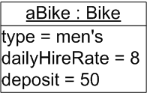
Object
Every object in a system has three characteristics : behaviour , state and identity
Object name
Class name
Attributes
The name of the object is aBike :Bike.
Object names are always underlined and can have two parts, either of which can be used on its own. The first part of the name, aBike, labels the object; the second part, :Biker identifies it as an object of the Bike class. There are a number of ways in which we can refer to an object: we can talk about 'an object of the Bike class', 'a Bike object', or ':Bike' - all of these names mean the same thing in this context.

Slide 10
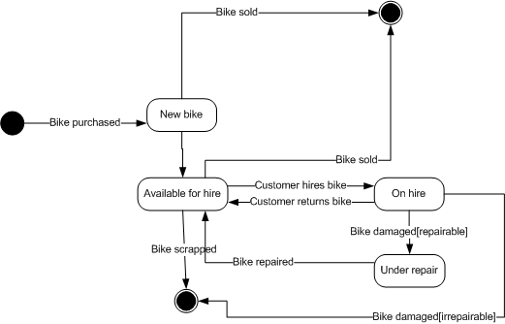
Characteristics of an Object
State
  The state of an object is determined by the values of its attributes and its links to other objects

Slide 11
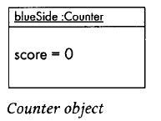
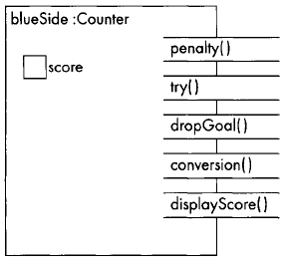
Encapsulation and
Information Hiding
As an example, let us design a counter to
keep track of the score in a game of rugby. We shall have an object
called blueSide :Counter with an attribute score
blueSide is the name of the object, Counter is its class.
The scoring system in a game of rugby is that a side gets 3
points for a penalty, 3 for a drop goal 5 for a try and 2 for a

Slide 12
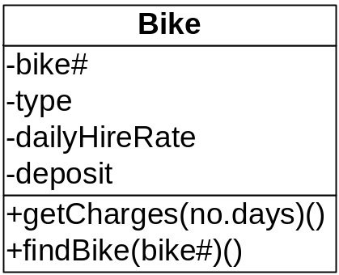
Encapsulation and
Information Hiding
For example : a Bike object knows that it can display its number and work out of the cost of hiring it (or rather the bike it represents) for a given number of days . However, the code for these operations is part of the Bike class
Figure : The Bike class form the Wheels system

Slide 13
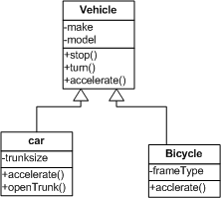
Polymorphism
Polymorphism, meaning many shaped, refers to the use of the same method name in different classes to perform a variety of purposes.
Polymorphism is a concept that permit different objects to respond differently to the same message

Slide 14
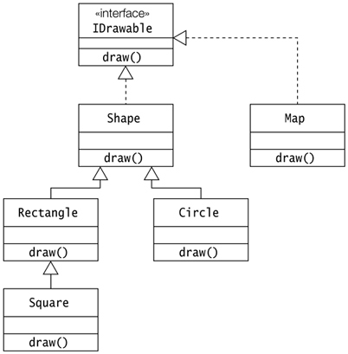
Another Example

Slide 15
Polymorphism
Operation overriding
  Occurs when a parent class provides an operation but the inheriting child class defines its own version of that operation
  The operation in a subclass will override the operation in the superclass

Slide 16
Polymorphism
Operation overloading
  Occurs when several operations in a single class have the same name but will act differently according to the number of parameters that are passed to the operation when it is called

Slide 17
References
Britton, C.. (2005). A student Guide to Object Oriented Development. 01. Butterworth-Heinemann. Amsterdam. ISBN: 978-0-7506-6123-2.
Data encapsulation, http://java.about.com/od/objectorientedprogramming/a/encapsulation.htm
Object Oriented Concept, http://www.apl.jhu.edu/Classes/Notes/Demasco/605704/ObjectOrientedConcepts.pdf
Introduction to Object Oriented, http://java.about.com/od/objectorientedprogramming/a/introobjects.htm
What is class ?, http://java.sun.com/docs/books/tutorial/java/concepts/class.html

Slide 18
Q & A

Slide 19
Exercise
What are the main phases of object-oriented system development ?
List three ways in which object-oriented development differs from the traditional structured approach ?
What do we mean by (a) abstraction and (b) decomposition in the context of modelling software systems ?
What is a CASE tool ?

